Slide 1

Institute Technology of Cambodia
Subject : Data mining
Lecturers : PHAUK Sokkhey and CHAN Sophal
Name chhoem Sothy

Slide 2
Content
About
Content of paper
ABSTRACT
INTRODUCTION
Literature Review
Conclusion

Slide 3
About
Tittle: Prediction Analysis Techniques of Data Mining: A Review
Author: Himani Rani
Public: International Journal of Computer Science and Mobile Computing (IJCSMC Journal)
Date: May 2019

Slide 4
Content
INTRODUCTION
1.1. Classification in Data Mining
1.2 SVM classifier
2. Literature Review
Conclusion

Slide 5
ABSTRACT
Data mining within the databases is called a technique from which the extraction of necessary information can be done from the raw information. With the help of the prediction analysis technique provided by the data mining the future scenarios regarding to the current information can be predicted. The prediction analysis is the combination of clustering and classification.
KEYWORDS: Classification, Clustering, K-means, SVM.

Slide 6
INTRODUCTION
In data mining,various data mining tools available which are used to analyze different types of data. For analyzing the data information fewapplications which is used by data mining are such as making decisions, analysis on market basket, production control, andcustomer retention, scientific discovers and education systems.

Slide 7
INTRODUCTION
Classification in Data Mining
Prediction analysis is the process in which outcome will be predicted on the basis of current data. For example, on the basis of current weather information it will be analyzed that day
can be either “sunny”, “rainy “or “cloudy.
Two steps are followed within this process. They are
Model Construction
Model usage

Slide 8
INTRODUCTION
Classification in Data Mining
In this study the author proposed SVM classifier for regression, classification and also the general pattern recognition. Due toits high generalization performance without requiring any prior knowledge to add in it, this classifier is considered to be goodin comparison to other classifiers. The performance is even better such as extremely high of the input space dimension

Slide 9
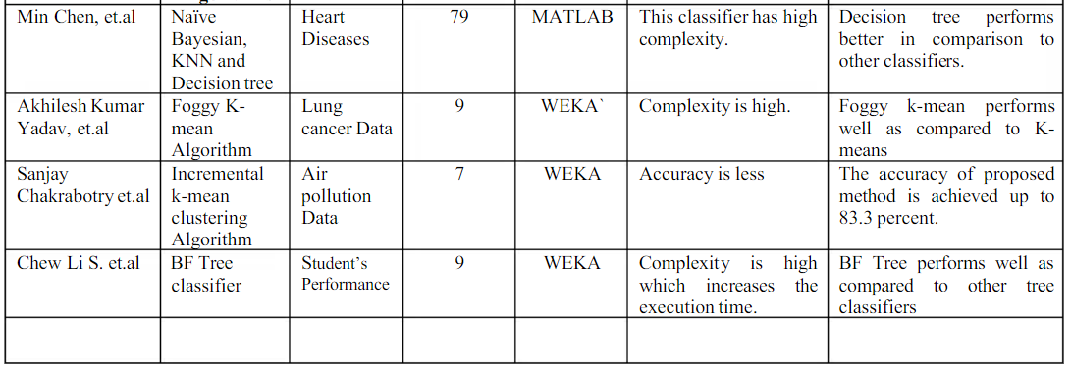
Literature Review

Slide 10
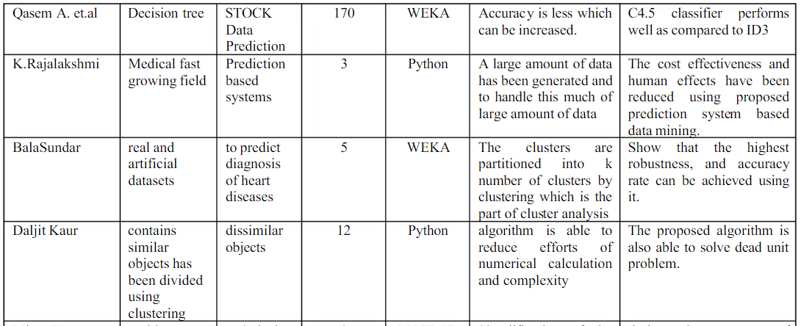
Literature Review

Slide 11
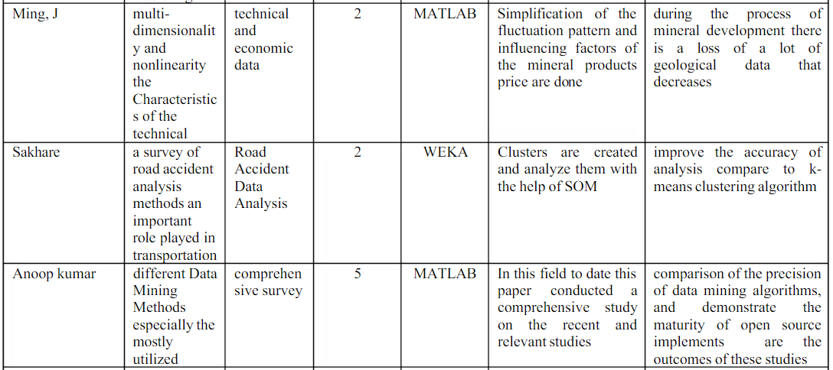
Literature Review

Slide 12
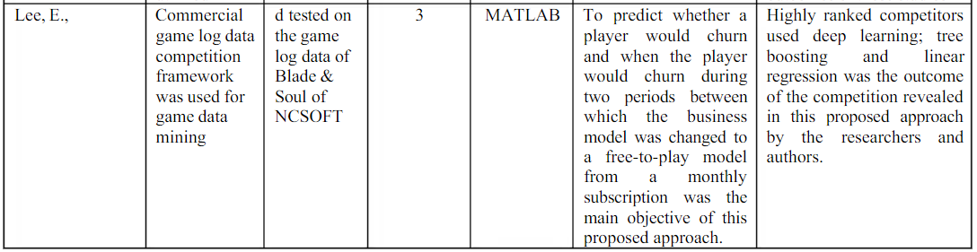
Literature Review

Slide 13
Conclusion
In terms of many parameters several predictionanalysis algorithms are reviewed and analyzed in this paper. The literature survey is done on various techniques of predictionanalysis from where problem is formulated. The formulated problem can be solved in future to increase accuracy of prediction analysis

